Slide 1
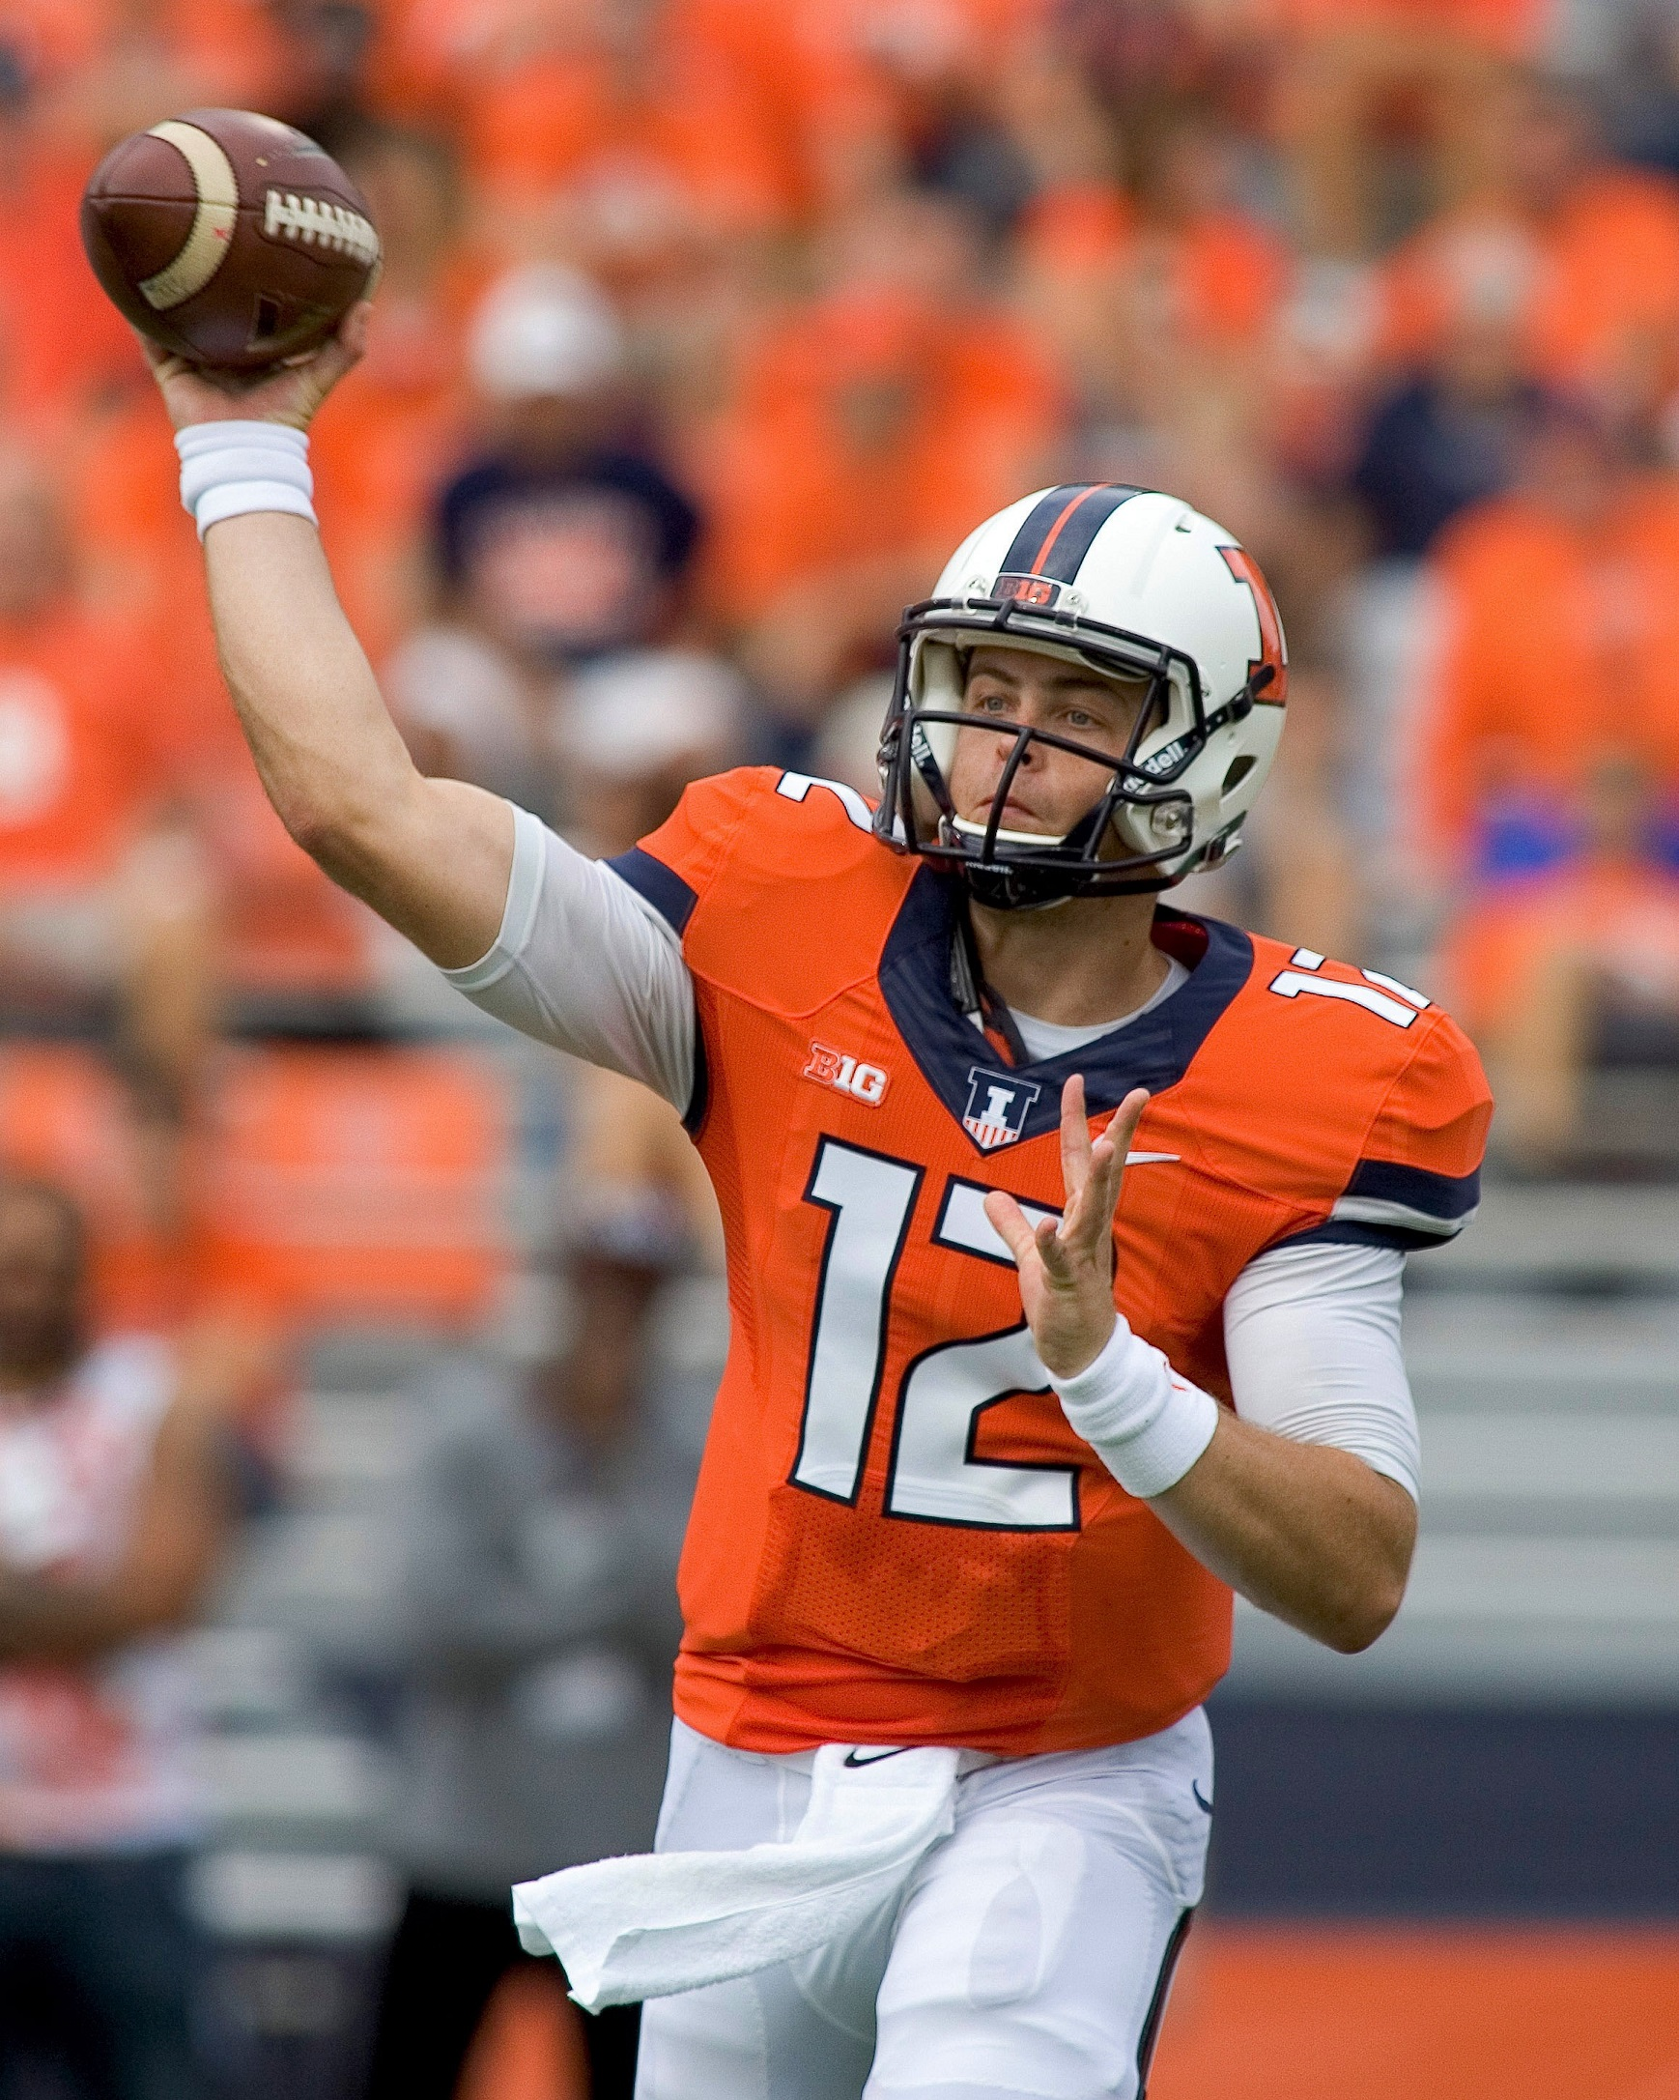


A Bayesian Approach to Predicting NFL Player Scores in Fanduel Tournaments
Aaron Ray (aaronwr2)
Michael Chan (mhchan3)
Kiomars Nassiri (nassiri2)
STAT 578 - ABM

Slide 2


FanDuel
Web-based, fantasy sports company founded in 2009.
Over 6 million registered users.
2nd largest of its kind.
Revenue driven by entry fees.

Slide 3

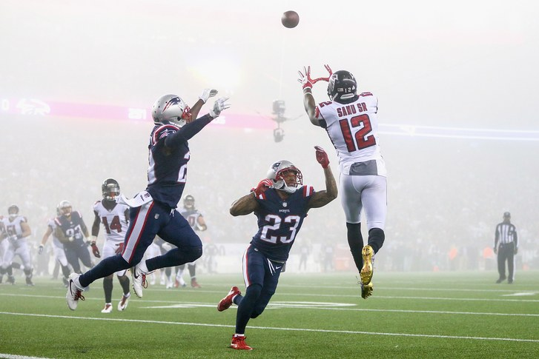
Daily Fantasy Football
Participants manage a 9-man virtual lineup.
The goal is to maximize points potential.
Points are scored based on actual player performance.
Players are purchased with virtual salaries that increase with estimated player potential.
Each lineup is constrained by a virtual salary cap that cannot be exceeded by the sum total of player salaries.

Slide 4
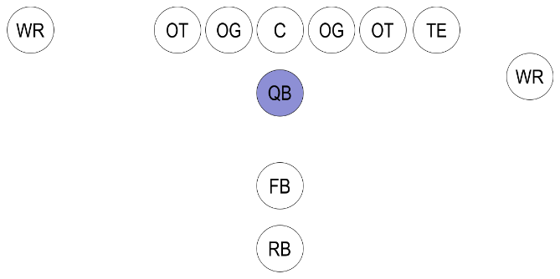
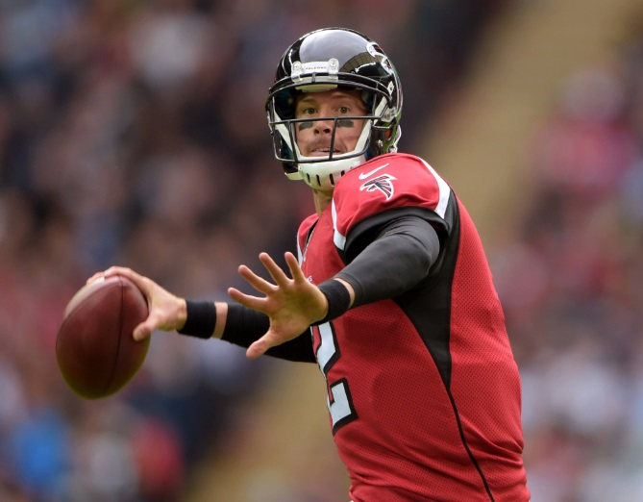
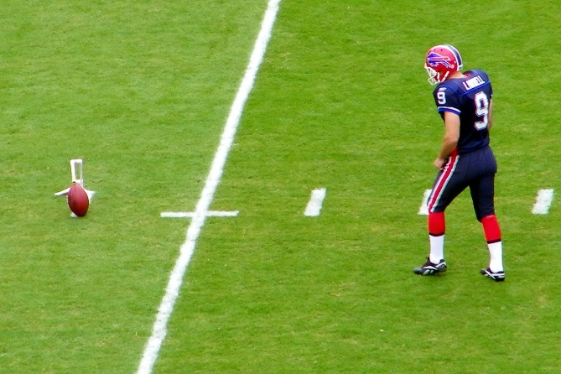
Research Questions & Objective
“QBs or Quarterbacks are members of the offensive team and line up directly behind the offensive line. They are considered the leader of the offensive team.” – Wikipedia
Objective
Leverage Bayesian hierarchical model with Markov Chain Monte Carlo simulation to predict fantasy points scored by an NFL quarterback (QB) or placekicker (PK).
Questions
What features can help us effectively predict Fanduel points scored by each player?
How reliable are predictions using a Bayesian approach?
“PKs or Placekickers are responsible for the kicking duties of field goals and extra points.” – Wikipedia

Slide 5

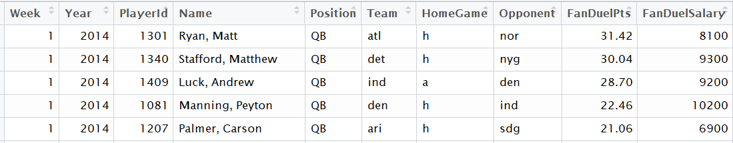
Dataset – Fanduel Stats
Historical data on the performance of the players is extracted from the RotoGuru website.
Seasons 2014 – 2017, Weeks 1- 16
Data includes information about:
Player weekly Fanduel points
Player position
Player opposing team
Game locale, year, week
Raw Data Fields | Description
Week | Match Week
Year | Match Year
Player ID | Player ID
Name | Player Name (Last, First)
Position | Player’s Position
Team | Player’s Team
HomeGame | Home/Away Indicator
Opponent | Player’s Opponent Team
FanDuelPts | FanDuel Points
FandDuelSalary | FanDuel Salary

Slide 6
Data Preparation and Wrangling
Data from RotoGuru needed some clean up and preparation:
Data Cleansing:
Removed invalid records, binarized Home/Away indicators, and fixed some other issues.
Data Wrangling:
6-week running mean and SD of PAP.
5-week running mean and SD of player fanduel points.
Offensive and Defensive Ranks.
Points Allowed to Position (PAP): This metric represents the typical total points that each player’s opponent has allowed to players of that position in any given game.

Slide 7
Overview of the Bayesian Model
Response Variable:
FanDuel Points Received
Predictor Variables:
5-week running mean of the points scored
6-week running mean of PAPs.
Position
Home Advantage Indicator
Rank: The rank of a player based on recent performance.

Slide 8
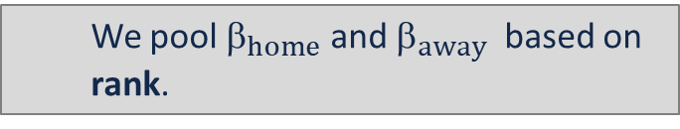
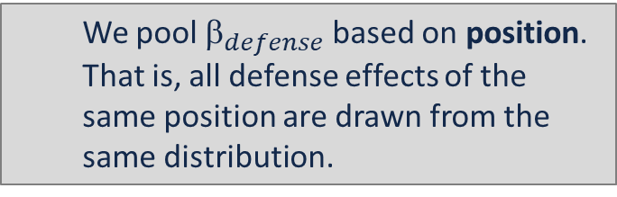
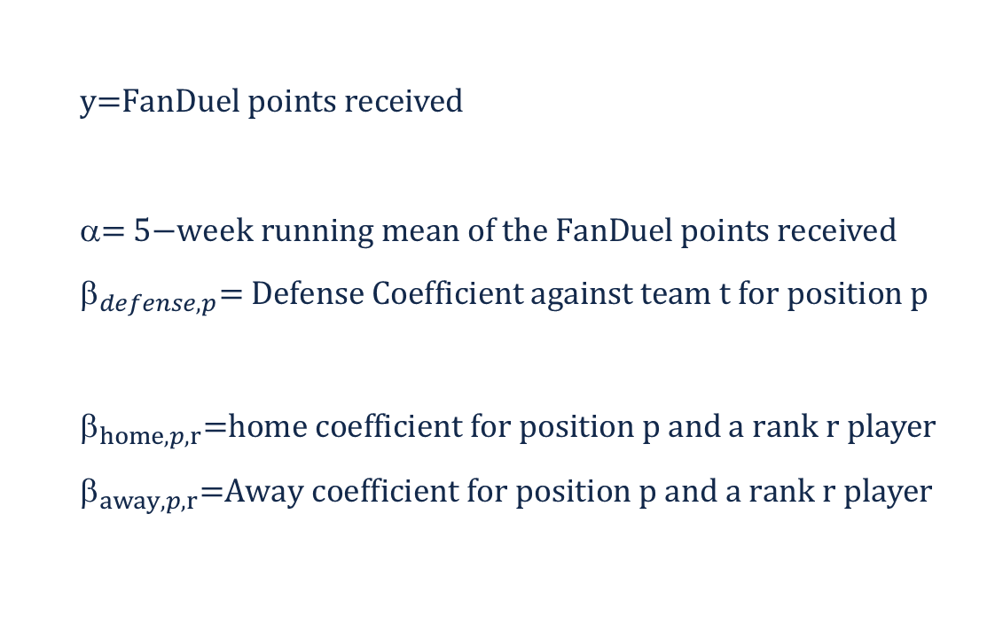
Sampling Model
We have assumed performance (FanDuel points) is normally distributed around a true mean value
$$\text{y}\text{=}\text{FanDuel} \text{points} \text{received}$$
$$\text{= }\text{5−}\text{week} \text{running} \text{mean} \text{of} \text{the} \text{FanDuel} \text{points} \text{received}$$
$${\text{}}_{defense,p}\text{= }\text{Defense} \text{Coefficient} \text{against} \text{team} \text{t} \text{for} \text{position} \text{p}$$
$${\text{}}_{home,p,r}\text{=}\text{home} \text{coefficient} \text{for} \text{position} \text{p} \text{and} \text{a} \text{rank} \text{r} \text{player}$$
$${\text{}}_{away,p,r}\text{=}\text{Away} \text{coefficient} \text{for} \text{position} \text{p} \text{and} \text{a} \text{rank} \text{r} \text{player}$$
We pool ${\text{}}_{defense}$based on position. That is, all defense effects of the same position are drawn from the same distribution.
We pool ${\text{}}_{home}$ and ${\text{}}_{away}$ based on rank.

Slide 9
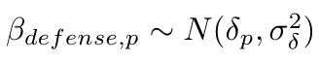
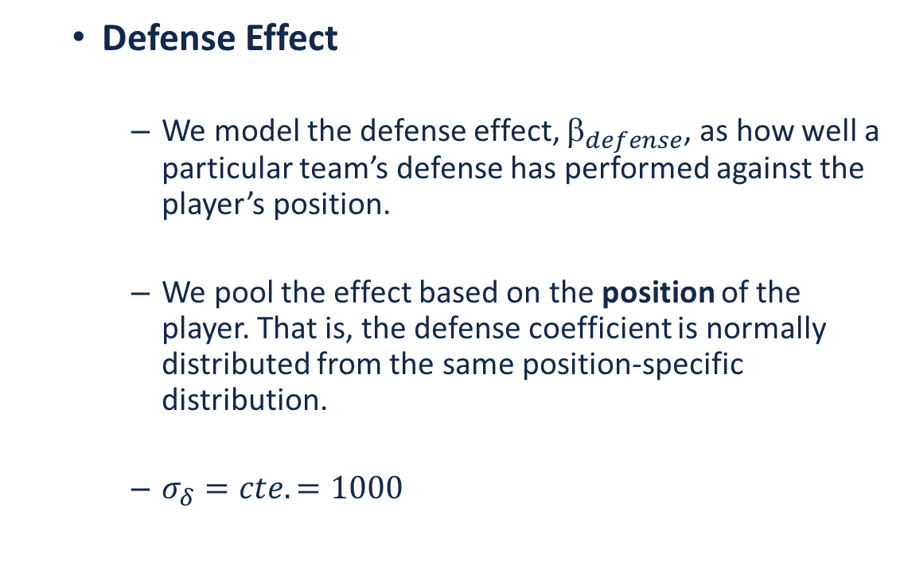
Sampling Model (Cont’d)
Defense Effect
We model the defense effect, ${\text{}}_{defense}$, as how well a particular team’s defense has performed against the player’s position.
We pool the effect based on the position of the player. That is, the defense coefficient is normally distributed from the same position-specific distribution.
$σ_{δ}=cte.=1000$
X
η
β_{home}
ρ
β_{away}
y
σ_{y}²
Rank
N
δ
β_{defense}
Position

Slide 10
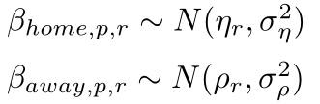
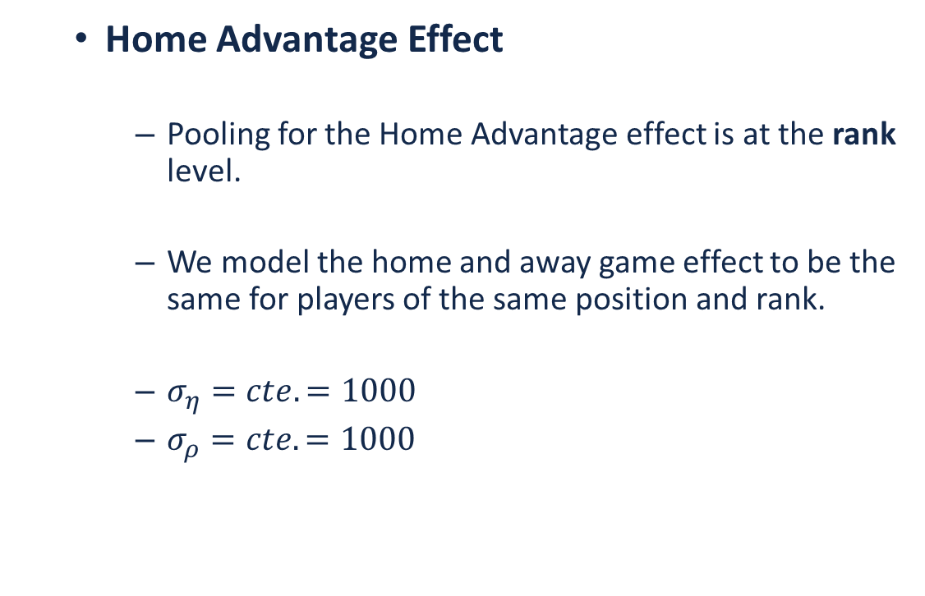
Sampling Model (Cont’d)
Home Advantage Effect
Pooling for the Home Advantage effect is at the rank level.
We model the home and away game effect to be the same for players of the same position and rank.
$σ_{η}=cte.=1000$
$σ_{ρ}=cte.=1000$
X
η
β_{home}
ρ
β_{away}
y
σ_{y}²
Rank
N
δ
β_{defense}
Position

Slide 11
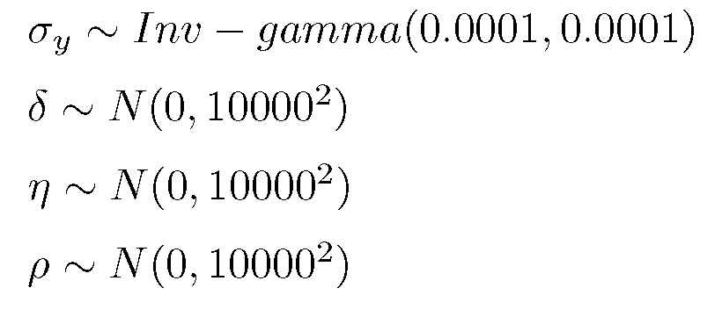
Priors
We have chosen our prior distributions to be proper (but diffuse and non-informative):
X
η
β_{home}
ρ
β_{away}
y
σ_{y}²
Rank
N
δ
β_{defense}
Position

Slide 12
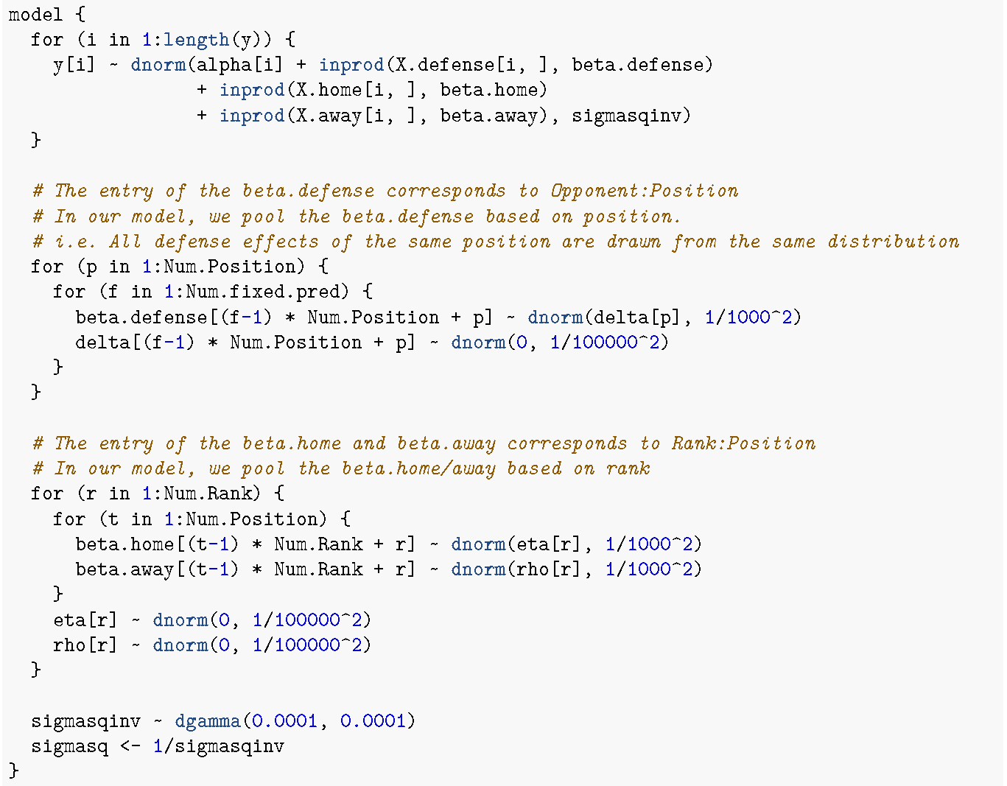
BUG Model Specification
X
η
β_{home}
ρ
β_{away}
y
σ_{y}²
Rank
N
δ
β_{defense}
Position

Slide 13
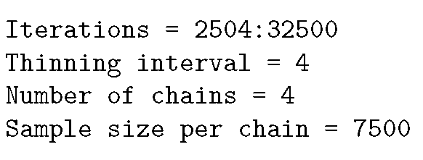
Modeling Process & Results
Note: Due to significant roster changes that usually happen during the off-season period, it was decided not to use data across seasons.
Initialization: Set up initializations for 4 chains with different over-dispersed starting points.
Modeling Data: 2016 data is used for modeling as it is the most recent year with a full season.
Prediction Data: Last week of 2016 is set aside to test model prediction accuracy.
Convergence: Convergence diagnostics are conducted using trace plots and the Gelman statistic.
Effective Sample Size: The threshold for effective sample size is assumed to be 400.

Slide 14
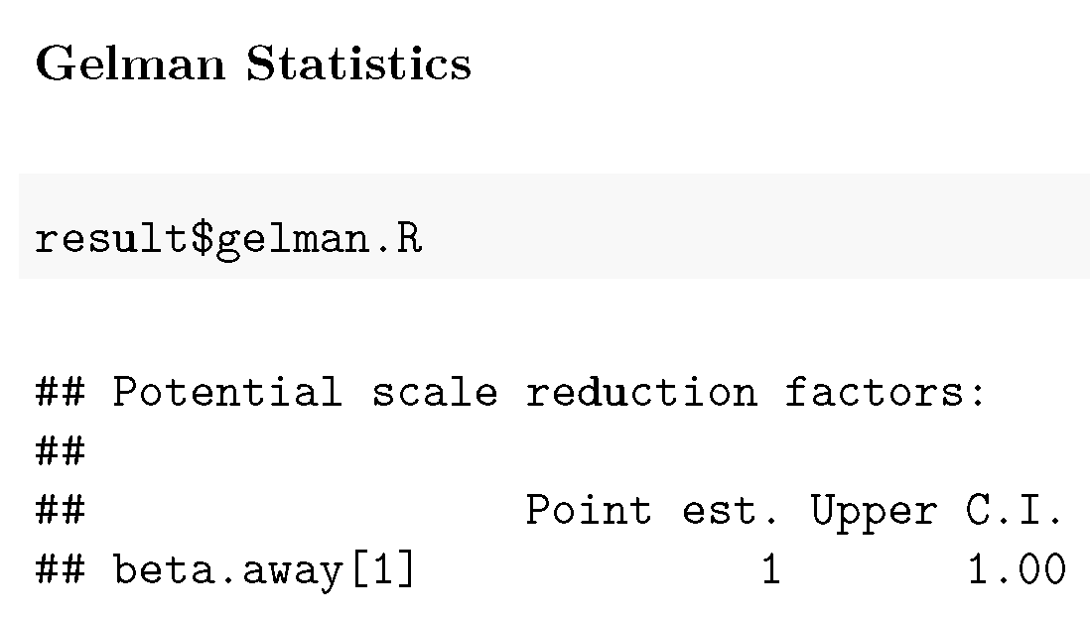
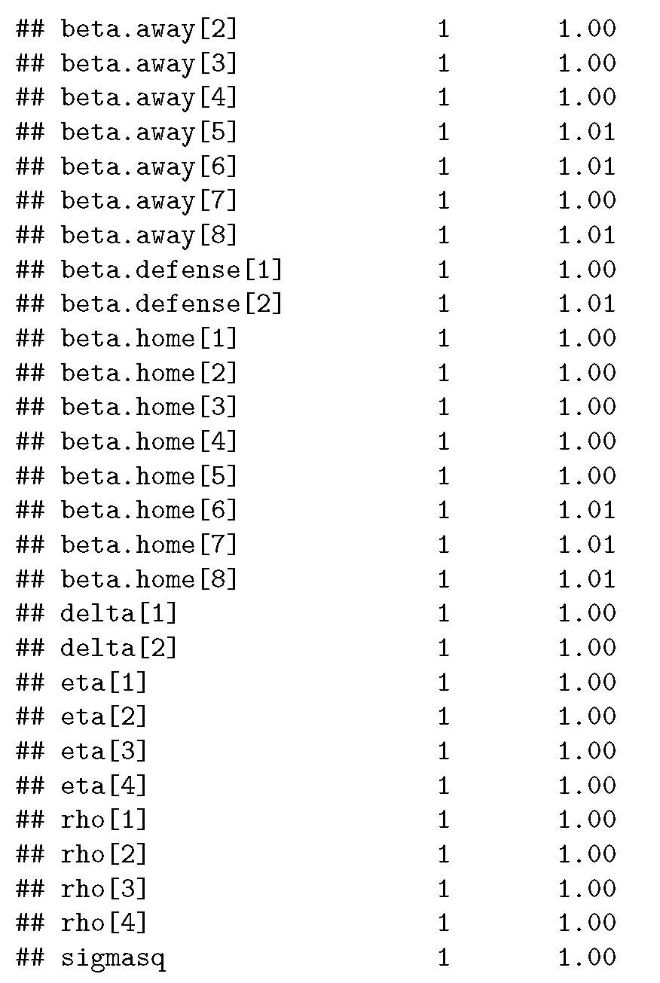
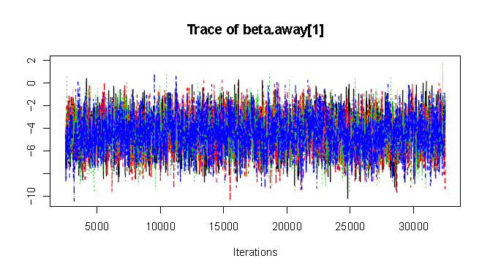
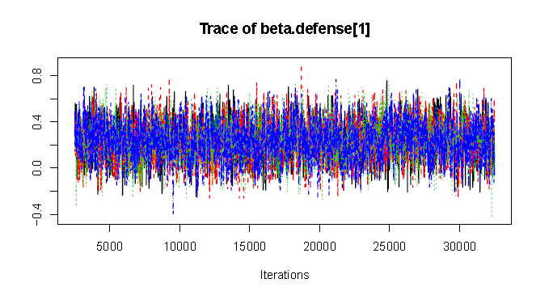
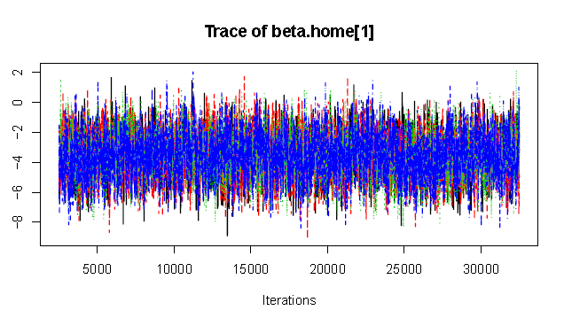
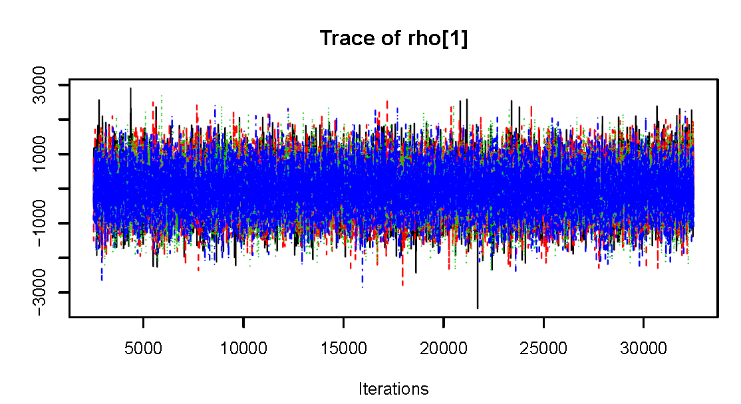
Modeling Process & Results (Cont’d)
Convergence Diagnostics:
Trace Plots of all of the parameters show good distribution convergence. Here are a few of the trace plots:

Slide 15
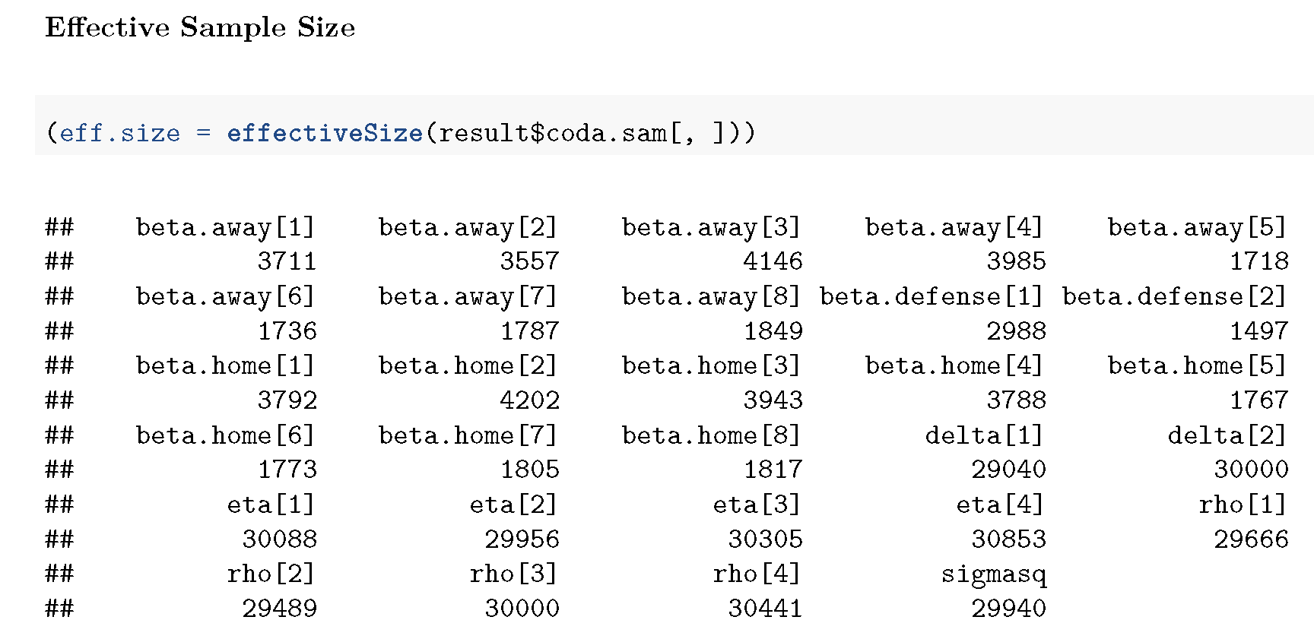
Modeling Process & Results (Cont’d)
Effective Sample Size:
Effective sample size of all parameters are greater than the threshold (400) and seem adequate.

Slide 16
Modeling Process & Results (Cont’d)
Model Summary Results:
Here are some of the summary results for the model parameters:
## Iterations = 2504:32500
## Thinning interval = 4
## Number of chains = 4
## Sample size per chain = 7500
##
## 1. Empirical mean and standard deviation for each
## variable, plus standard error of the mean:
##
## Mean SD Naive SE Time-series SE
## beta.defense[1] 0.235 0.156 0.000898 0.00285
## beta.defense[2] -0.075 0.109 0.000632 0.00283
##
## 2. Quantiles for each variable:
##
## 2.5% 25% 50% 75% 97.5%
## beta.defense[1] -0.0663 0.129 0.2350 0.33995 0.543
## beta.defense[2] -0.2931 -0.148 -0.0741 -0.00196 0.138

Slide 17
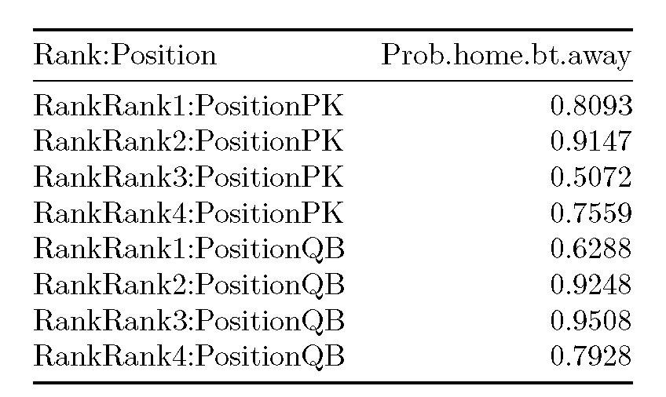
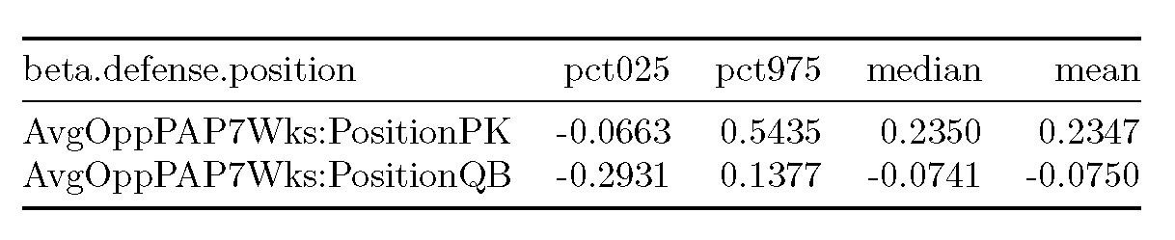
Model Assessment
General Posterior Results Check:
Probability of performing better in Home games:
As expected, players in different ranks and positions are performing better in Home games in comparison with Away games based on Posterior.
Probability of performing better when playing against teams with worse defense records:
The median for PKs are positive, as expected, but median for QBs are slightly negative; meaning that QBs actually score less points against teams with not-so-well defensive records.

Slide 18
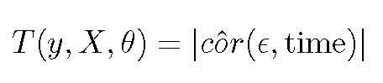
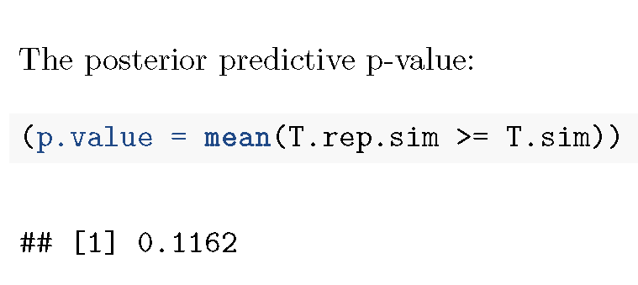
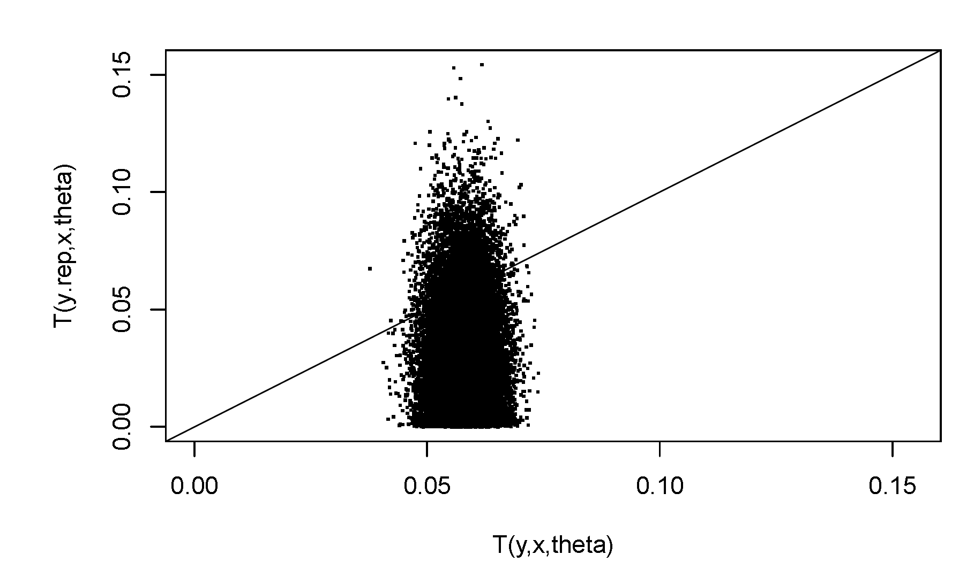
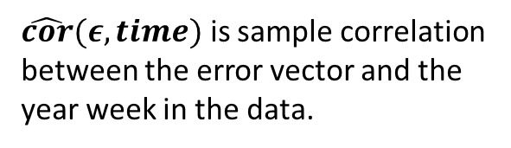
Model Assessment (Cont’d)
Posterior Predictive Check
Temporal Error Correlation Check:
Larger numbers of this test quantity indicate a correlation between errors and time.
The calculated p-value is more than the conventional threshold p-value of 0.05 and therefore, does not indicate any temporal correlation issues in the model.
$\hat{cor}(ε,time)$ is sample correlation between the error vector and the year week in the data.

Slide 19
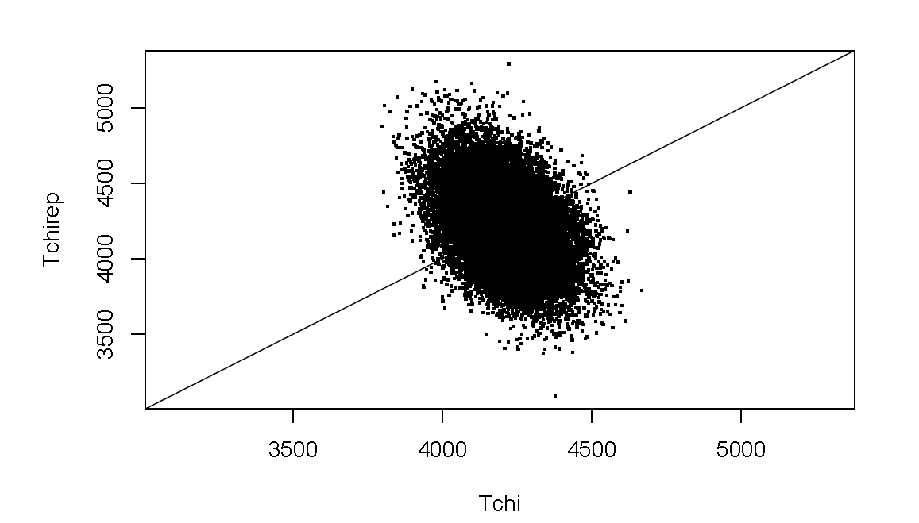
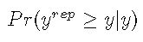
Model Assessment (Cont’d)
Posterior Predictive Check
Chi-Square Discrepancy Check
The calculated p-value using the Chi-Square discrepancy measure is 0.5057 which is more than the conventional threshold p-value of 0.05 and therefore, does not indicate any evidence of issues in the model.
Individual Data Point Discrepancy Check
The posterior predictive p-value using individual data points is 0.5076 which is again greater than 0.05 and therefore, is not indicative of any issues in the model.

Slide 20
Model Assessment (Cont’d)
Posterior Predictive Check
Non-negativity check
For the sake of simplicity, we have decided to use normal distribution instead of Poisson. To investigate whether this simplification has caused any issues, we checked the model for negative predicted y values.
The ratio of the predictions that are less than zero are 0.0463 which is a relatively small number and can justify usage of Normal distribution for modeling purposes.

Slide 21
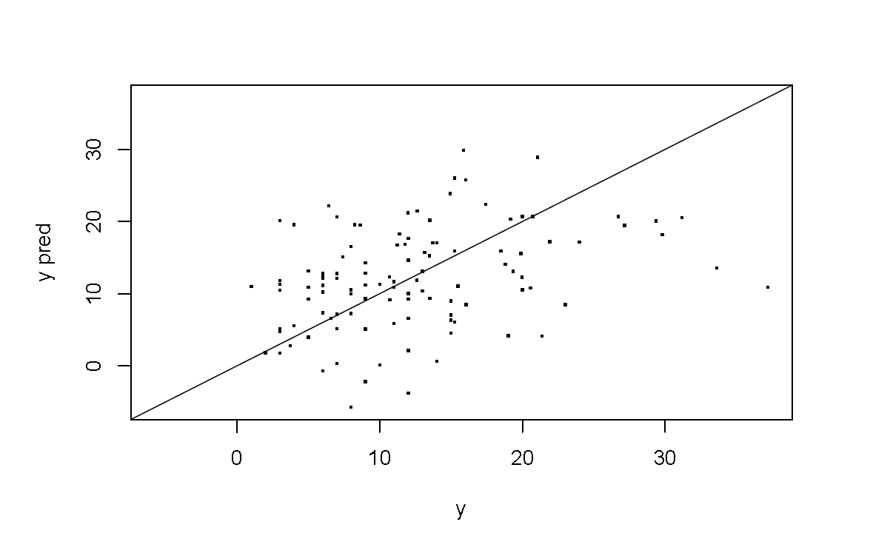
Prediction
As discussed before, we have used the last week of 2016 to test the prediction accuracy of our model.
Prediction of Individual Player Performance
We have tested the model for a random player.
Overall Prediction Effectiveness
To measure the overall prediction effectiveness, we looked at the Pr(y_{rep}>=y) as a posterior p-value.
The result is 0.4683 which is close to 0.5. This implies a relatively good predictive value.
Actual FanDuel Points | 95% Posterior Central Prediction Interval
 | Lower Bound | Higher Bound
7.42 | 4.944 | 27.266

Slide 22
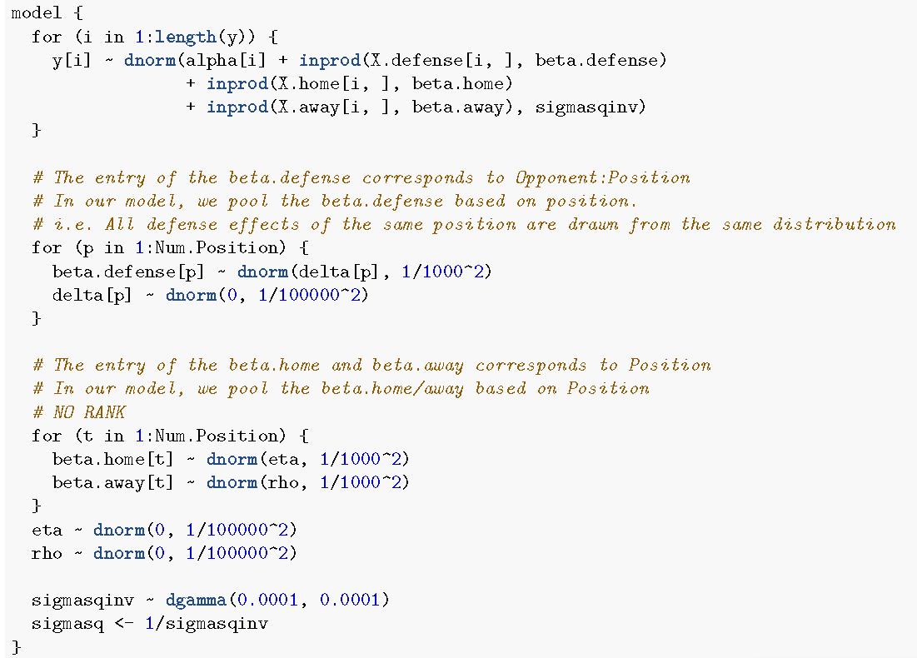
DIC – Alternative model
For the purpose of comparison, we have created an alternative model without considering Rank as a measure.
This model converges (Gelman R_{max}=1.0017<1.1) and all its effective sample sizes are > 400.
However, DIC of the main Model is lower than the alternative model →
“Main model (with Rank) performs better for prediction purposes.”
Model | DIC | Penalty
Main Model | 4719 | 19
Alt. Model | 4781 | 7.02
Main Model
Alt. Model

